Slide 1
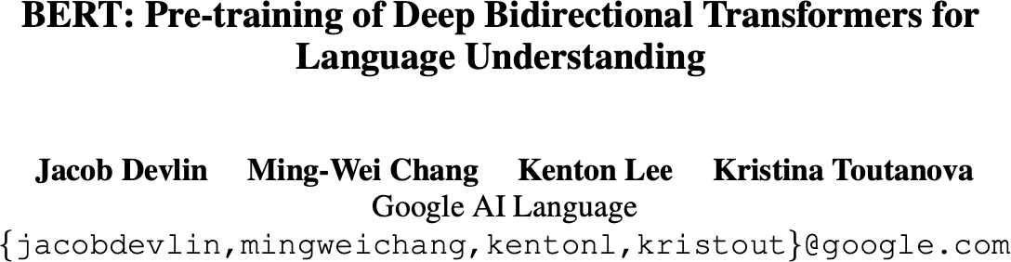
Released in 2018/10
Some slides are adapted from COS 597G course lecture slides from Princeton university course Fall 2022

Slide 2

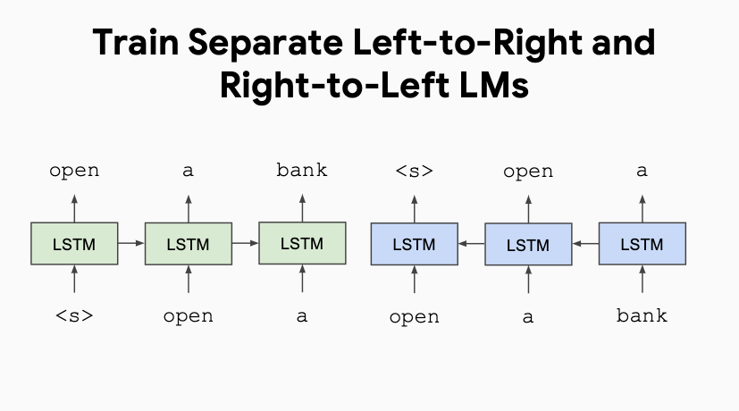
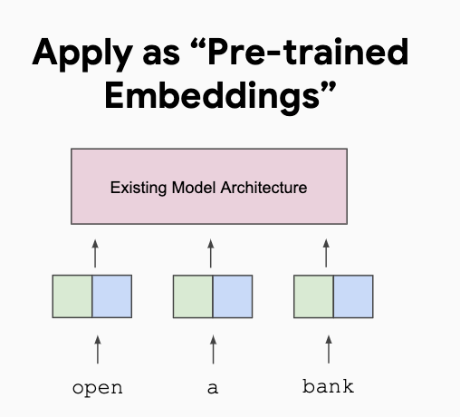
Prior work: ELMo
ELMo (Peters et al., 2018; NAACL 2018 best paper)
Train two separate unidirectional LMs (left-to-right and right-to-left) based on LSTMs
Feature-based approach: pre-trained representations used as input to task-specific models
Trained on single sentences from 1B word benchmark (Chelba et al., 2014)
Notes:
ELMo uses the concatenation of independently trained left-to-right and right-to left LSTMs to generate features for downstream tasks. ELMo is a feature-based approach

Slide 3
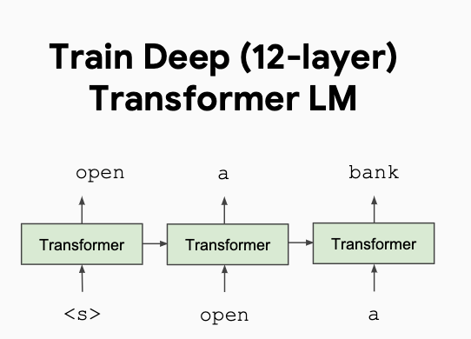
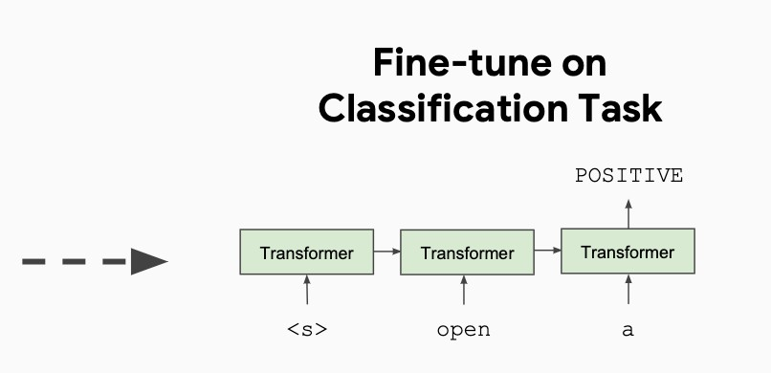
Prior work: OpenAI GPT
OpenAI GPT (Radford et al., 2018; released in 2018/6)
Train one unidirectional LM (left-to-right) based on a deep Transformer decoder
Fine-tuning approach: all pre-trained parameters are re-used & updated on downstream tasks
Trained on 512-token segments on BooksCorpus — much longer context!
Notes:
OpenAI GPT uses a left-to-right TransformerBERT and OpenAI GPT are fine-tuning approaches

Slide 4

BERT: key contributions
It is a fine-tuning approach based on a deep Transformer encoder
The key: learn representations based on bidirectional context
Why? Because both left and right contexts are important to understand the meaning of words.
Example #1: we went to the river bank.
Example #2: I need to go to bank to make a deposit.
Pre-training objectives: masked language modeling + next sentence prediction
State-of-the-art performance on a large set of sentence-level and token-level tasks
Notes:
BERT uses a bidirectional Transformer. Among the three, only BERT representations are jointly conditioned on both left and right context in all layers. BERT and OpenAI GPT are fine-tuning approaches
Contex free word embedding:
Word2vec, glove
Transformer Encoder only architecture

Slide 5
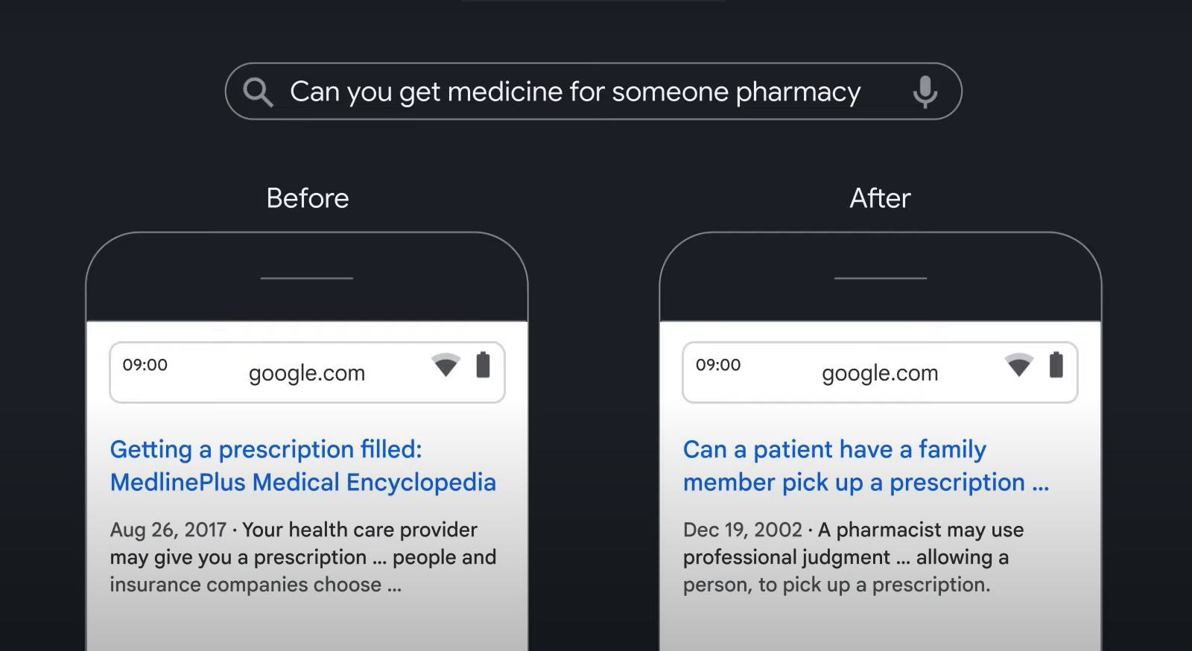
Improvement in google search after BERT was incorporated
Source:https://www.youtube.com/watch?v=t45S_MwAcOw

Slide 6
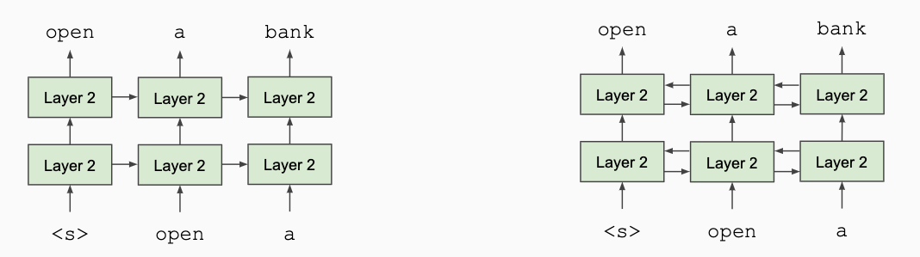
Masked Language Modeling (MLM)
Q: Why we can’t do language modeling with bidirectional models?
Solution: Mask out k% of the input words, and then predict the masked words
store gallon
the man went to [MASK] to buy a [MASK] of milk

Slide 7
MLM: masking rate and strategy
Q: What is the value of k?
They always use k = 15%.
Too little masking: computationally expensive
Too much masking: not enough context
See (Wettig et al., 2022) for more discussion of masking rates
Q: How are masked tokens selected?
15% tokens are uniformly sampled
Example: He [MASK] from [MASK] , Sri Lanka.

Slide 8
MLM: 80-10-10 corruption
For the 15% predicted words,
80% of the time, they replace it with [MASK] token
went to the store went to the [MASK]
10% of the time, they replace it with a random word in the vocabulary
went to the store went to the running
10% of the time, they keep it unchanged
went to the store went to the store
Why? Because [MASK] tokens are never seen during fine-tuning

Slide 9
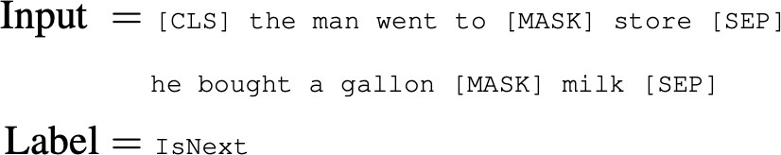
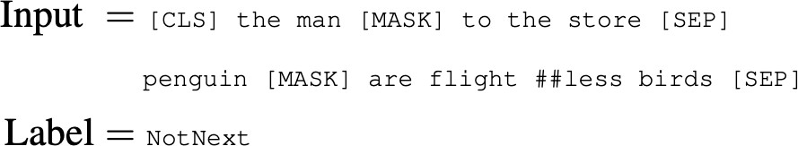
Next Sentence Prediction (NSP)
Motivation: many NLP downstream tasks require understanding the relationship between two sentences (natural language inference, paraphrase detection, QA)
NSP is designed to reduce the gap between pre-training and fine-tuning
[CLS]: a special token always at the beginning
[SEP]: a special token used to separate two segments
They sample two contiguous segments for 50% of the time and another random segment from the corpus for 50% of the time
Notes:
Binary classification task

Slide 10
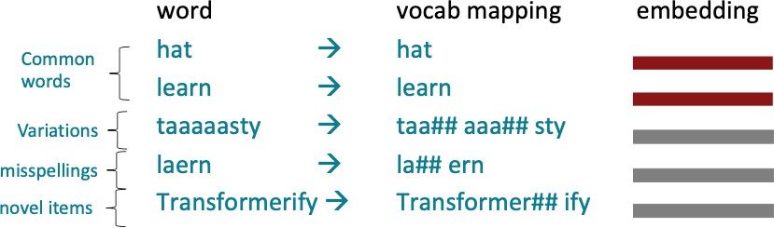
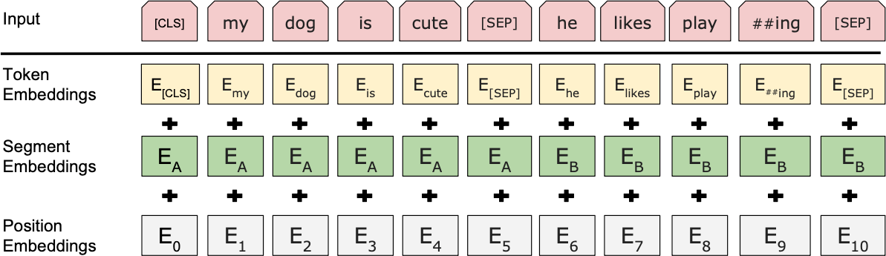
BERT pre-training: putting together
Vocabulary size: 30,000 workpieces (common sub-word units) (Wu et al., 2016)
(Image: Stanford CS224N)
Input embeddings:
Separate two segments
Notes:
Position embeddings to preserve the order of the tokens
Input sequences of length upto 512
Cls sep(for separating 2 segments)

Slide 11
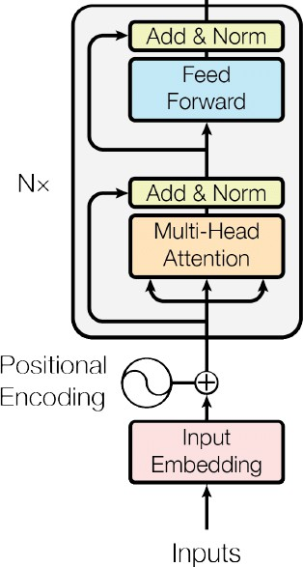
BERT pre-training: putting together
BERT-base: 12 layers, 768 hidden size, 12 attention heads,
110M parameters
Same as OpenAI GPT
BERT-large: 24 layers, 1024 hidden size, 16 attention heads, 340M parameters
OpenAI GPT was trained on BooksCorpus only!
Training corpus: Wikipedia (2.5B) + BooksCorpus (0.8B)
Max sequence size: 512 word pieces (roughly 256 and 256 for two non-contiguous sequences)
Trained for 1M steps, batch size 128k
Notes:
We use Adam with learning rate of 1e-4, 1 = 09, 2 = 0999, L2 weight decay of 001, learning rate warmup over the first 10,000 steps, and linear decay of the learning rate. We use a dropout prob ability of 0.1 on all layers. We use a gelu acti vation (Hendrycks and Gimpel, 2016) rather than the standard relu, following OpenAI GPT. The training loss is the sum of the mean masked LM likelihood and the mean next sentence prediction likelihood.

Slide 12
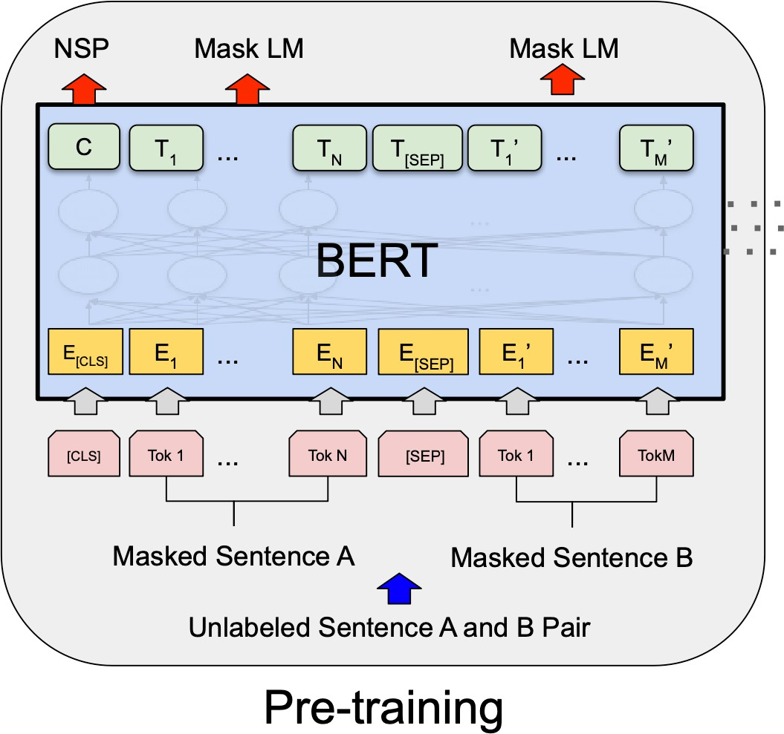
BERT pre-training: putting together
•
•
•
MLM and NSP are trained together [CLS] is pre-trained for NSP
Other token representations are trained for MLM

Slide 13
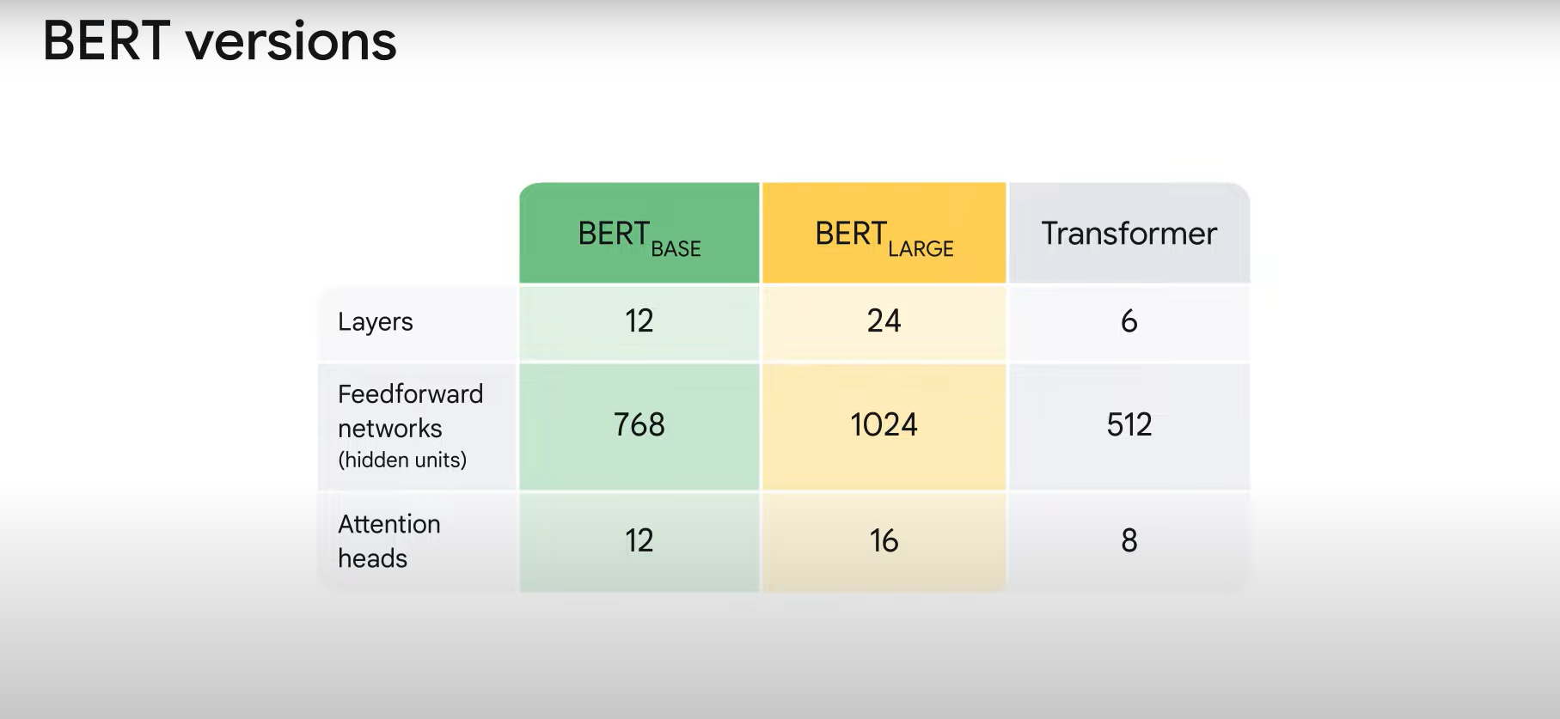
Source:https://www.youtube.com/watch?v=t45S_MwAcOw
Notes:
There are many more tinier versions today for

Slide 14
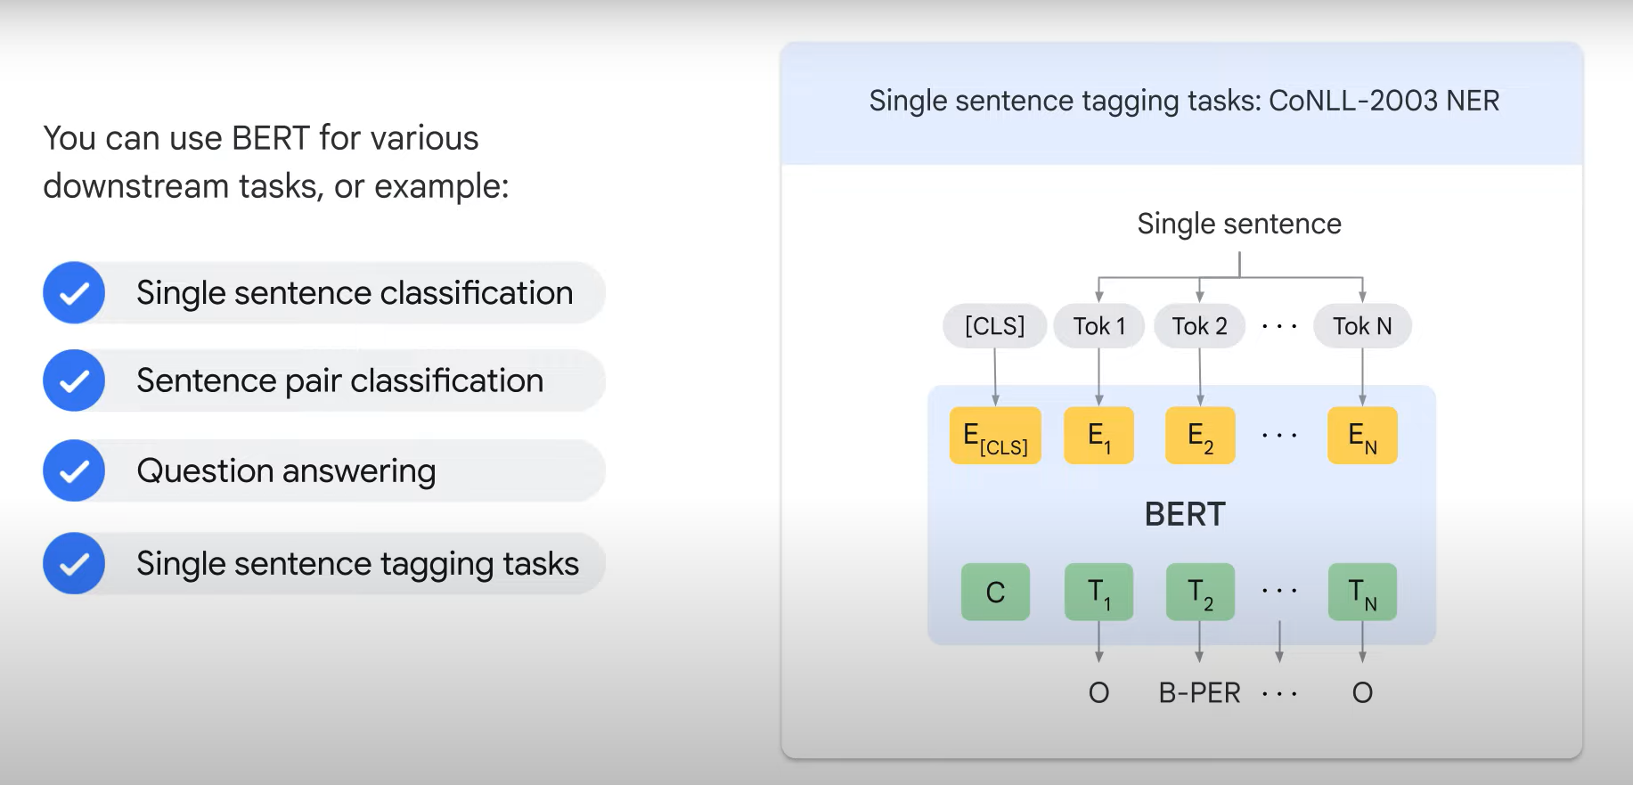
Source:https://www.youtube.com/watch?v=t45S_MwAcOw

Slide 15
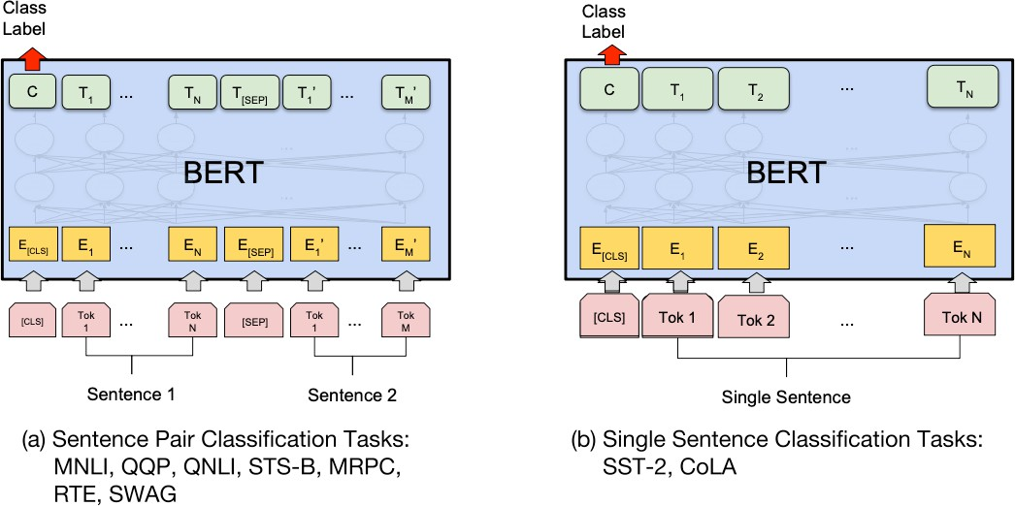
Fine-tuning BERT
“Pretrain once, finetune many times.”
sentence-level tasks
Notes:
Apart from output layers, the same architec tures are used in both pre-training and fine-tuning. The same pre-trained model parameters are used to initialize models for different down-stream tasks. During fine-tuning, all parameters are fine-tuned.
Compared to pretraining, finetuning is relatively inexpensive

Slide 16
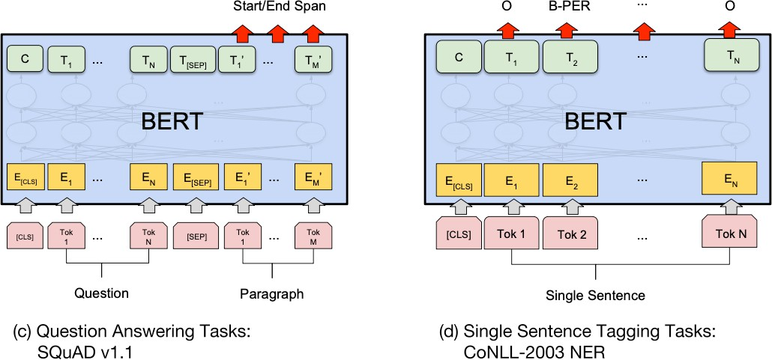
Fine-tuning BERT
“Pretrain once, finetune many times.”
token-level tasks

Slide 17

Sentence-level tasks
Sentence pair classification tasks:
Premise: A soccer game with multiple males playing.
Hypothesis: Some men are playing a sport.
MNLI
{entailment, contradiction, neutral}
Q1: Where can I learn to invest in stocks? Q2: How can I learn more about stocks?
QQP
{duplicate, not duplicate}
Single sentence classification tasks:
SST2
rich veins of funny stuff in this movie
{positive, negative}
(Wang et al., 2019): 6 sentence pair and 2 single-sentence tasks
Notes:
General language understanding evaluation(GLUE)
Multi genre natural language inference
Quora question pairs (qqp)
Stanford sentiment treebank (sst2)

Slide 18
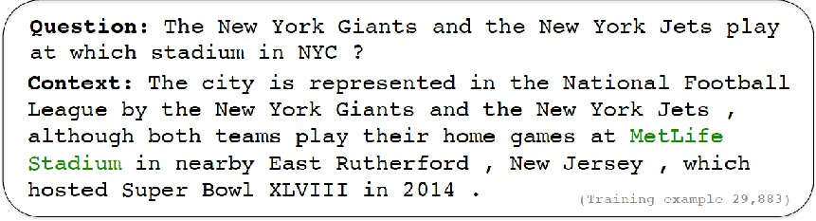
Token-level tasks
Extractive question answering e.g., SQuAD (Rajpurkar et al., 2016)
SQuAD
MetLife Stadium
Named entity recognition (Tjong Kim Sang and De Meulder, 2003)
CoNLL 2003 NER
John
B-PER
Smith
I-PER
lives in New York
O O B-LOC I-LOC
Notes:
B-PER beginning of a person entity
I-PER inside a person entity
Person, location, organization, misc

Slide 19
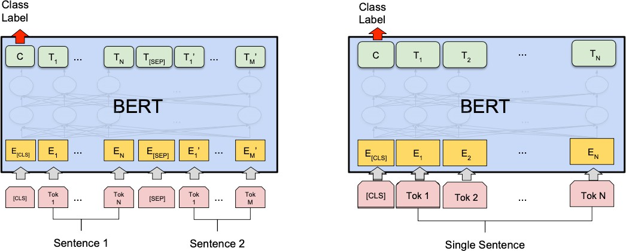
Fine-tuning BERT
•
•
For sentence pair tasks, use [SEP] to separate the two segments with segment embeddings
Add a linear classifier on top of [CLS] representation and introduce
c × h new parameters
C: # of classes, h: hidden size

Slide 20
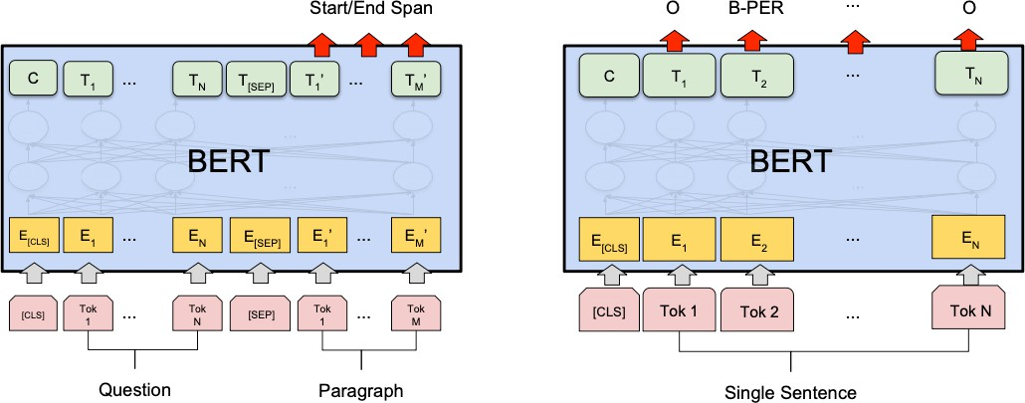
Fine-tuning BERT
•
For token-level prediction tasks, add linear classifier on top of hidden representations

Slide 21
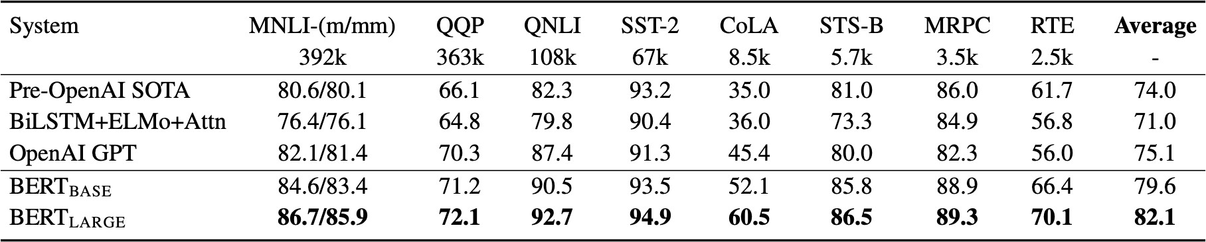
Experimental results: GLUE
Notes:
General language understanding evaluation(GLUE)
Multi genre natural language inference
Quora question pairs (qqp)
Stanford sentiment treebank (sst2)
The number below each task denotes the number of training examples.
F1 scores are reported for QQP and MRPC,Spearman correlations are reported for STS-B,and accuracy scores are reported for the other tasks.

Slide 22
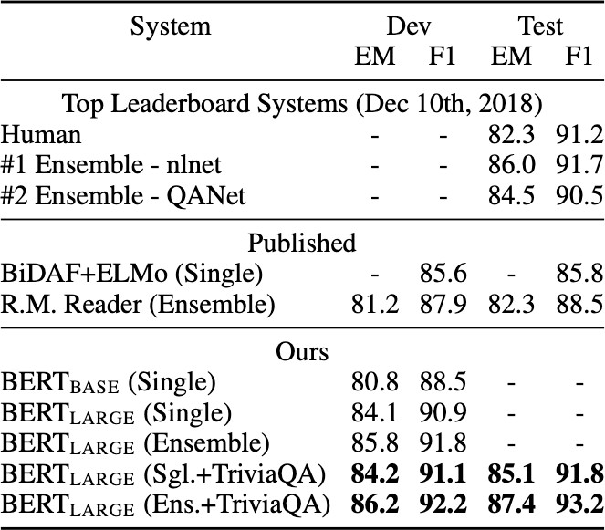
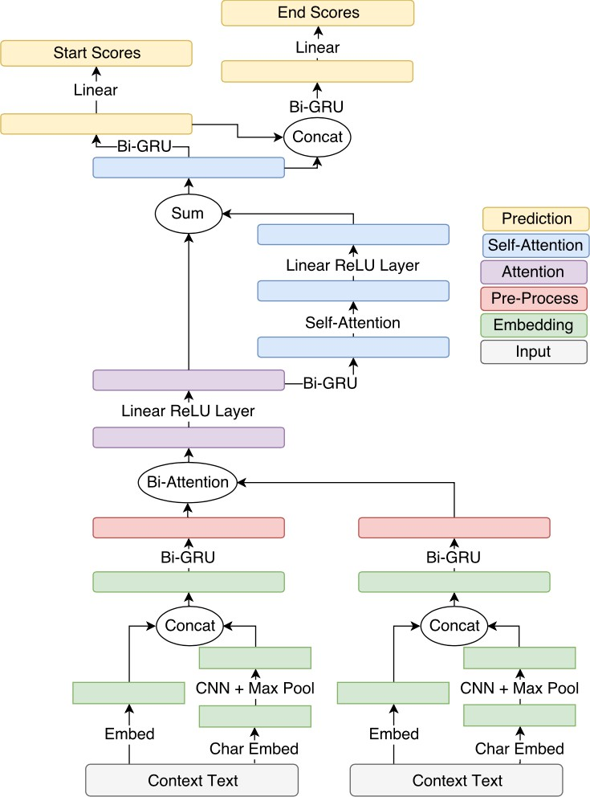
Experimental results: SQuAD
Notes:
the task is to predict the answer text span in the passage.

Slide 23
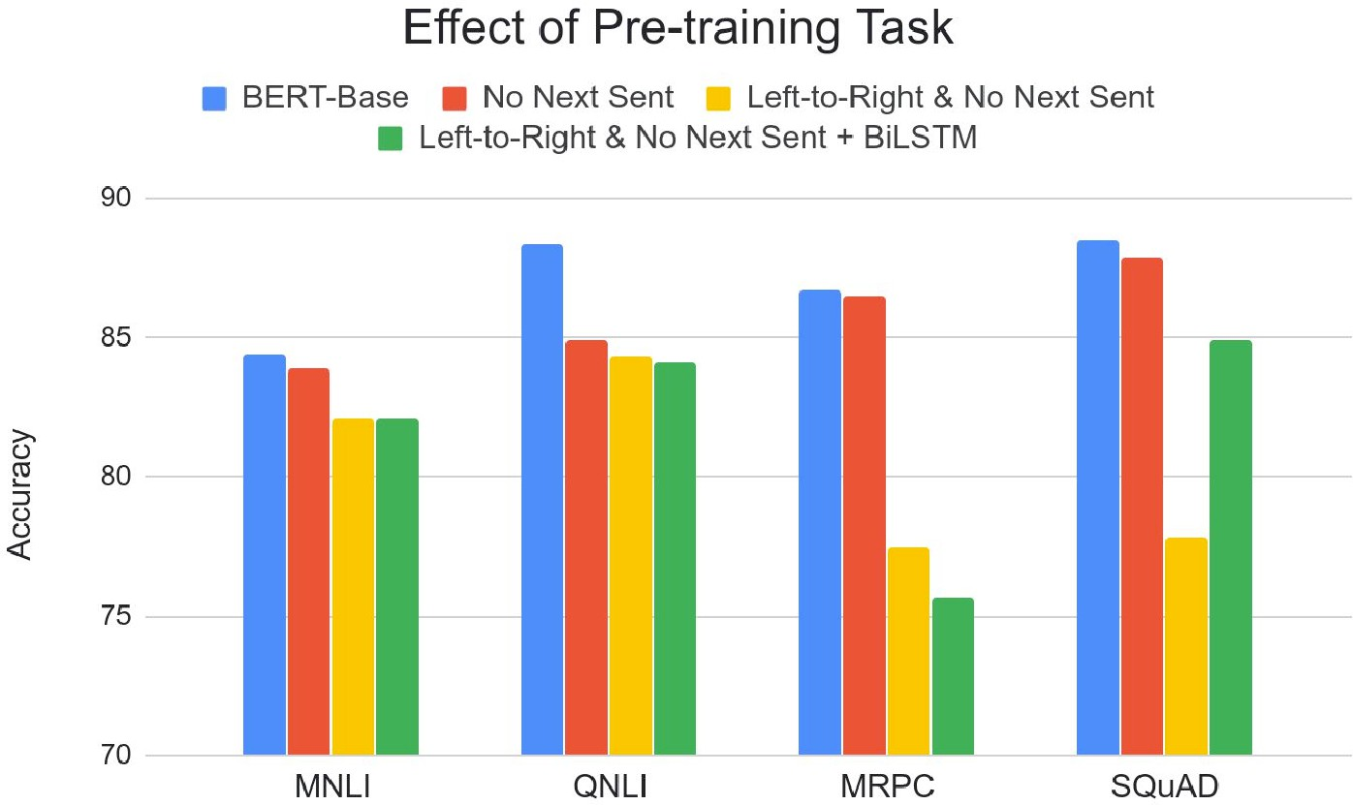
Ablation study: pre-training tasks
•
•
MLM >> left-to-right LMs
NSP improves on some tasks

Slide 24
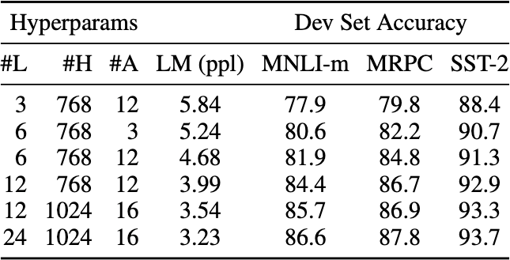
Ablation study: model sizes
hidden size
# of heads
# layers
The bigger, the better!
Notes:
Lm perplexity :lower is better

Slide 25
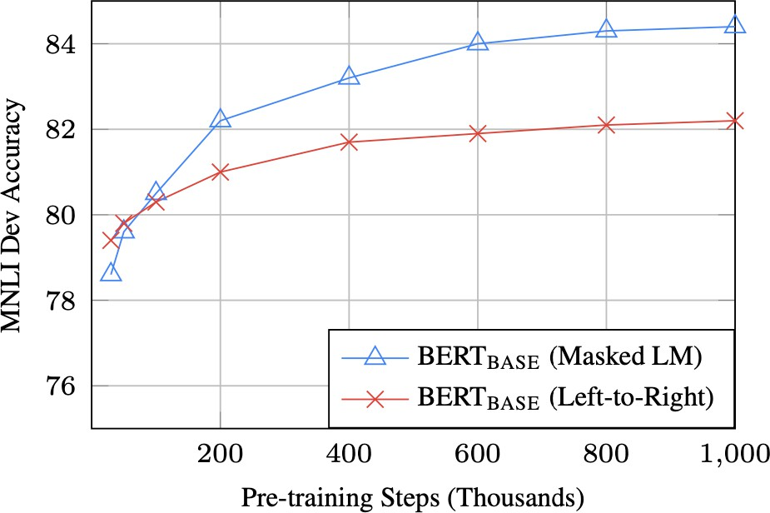
Ablation study: training efficiency
MLM takes slightly longer to converge because it only predicts 15% of tokens

Slide 26
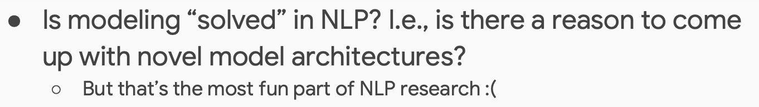
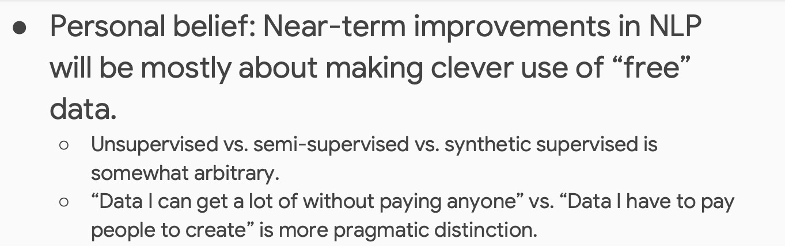
Conclusions (in early 2019)
From Jacob Devlin’s talk in 2019/1:

Slide 27
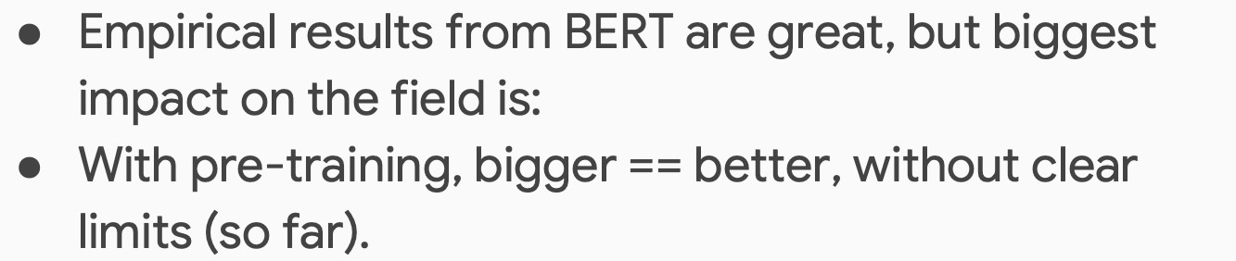
Conclusions (in early 2019)
From Jacob Devlin’s talk in 2019/1:

Slide 28
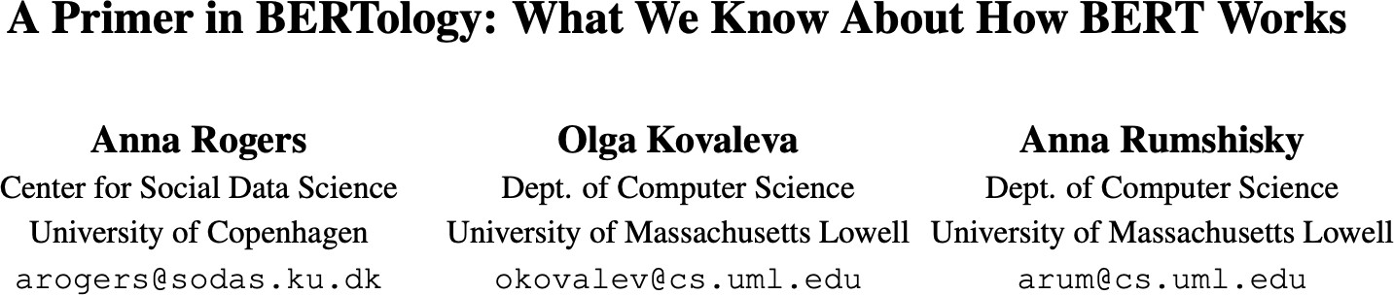
What happened after BERT?
Lots of people are trying to understand what BERT has learned and how it works
•
•
Syntactic knowledge, semantic knowledge, world knowledge…
How to mask, what to mask, where to mask, alternatives to masking..

Slide 29
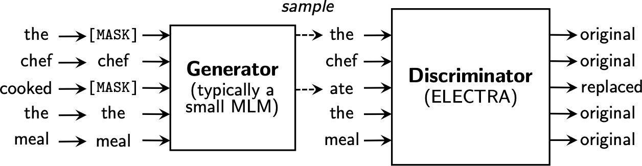
What happened after BERT?
RoBERTa (Liu et al., 2019)
Trained on 10x data & longer, no NSP
Much stronger performance than BERT (e.g., 94.6 vs 90.9 on SQuAD)
Still one of the most popular models to date
ALBERT (Lan et al., 2020)
Increasing model sizes by sharing model parameters across layers
Less storage, much stronger performance but runs slower..
ELECTRA (Clark et al., 2020)
It provides a more efficient training method by predicting 100% of tokens instead of 15% of tokens

Slide 30
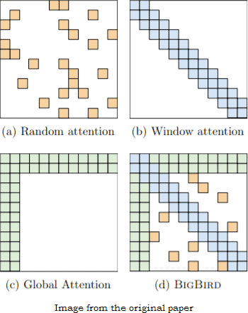
What happened after BERT?
Models that handle long contexts (≫ 512 tokens)
Longformer, Big Bird, …
Multilingual BERT
Trained single model on 104 languages from Wikipedia. Shared 110k WordPiece vocabulary
BERT extended to different domains
SciBERT, BioBERT, FinBERT, ClinicalBERT, …
Making BERT smaller to use
DistillBERT, TinyBERT, …

Slide 31
Let’s dive into the code

